Slide 1

PISHON ENTERPRISES
…..SHOPPING MADE EASY

Slide 2
Our Concern
KEY TASKS
Dashboard Components:
- Sales Performance:
- Total sales revenue
- Sales by region
- Sales by product category
- Sales trend over time
- Customer Insights:
- Customer segmentation
- Customer lifetime value
- Average order value
- Customer retention rate
- Product Trends:
- Best-selling products
- Product category performance
- Product seasonality
As a Data Scientist, create a comprehensive sales dashboard for Pishon Enterprises, a sales company, using Power BI. The dashboard should provide insights into sales performance, customer behavior, and product trends, enabling data-driven decision-making.

Slide 3
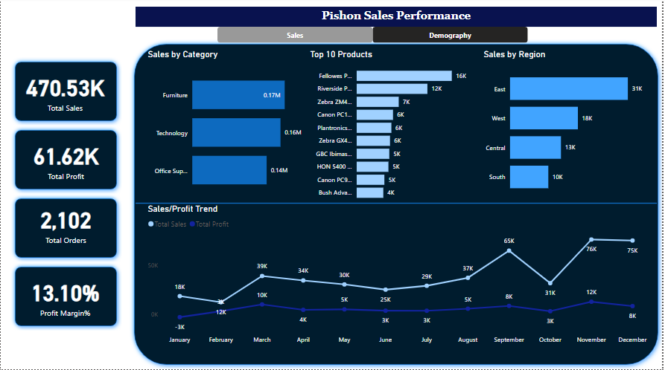

Slide 4
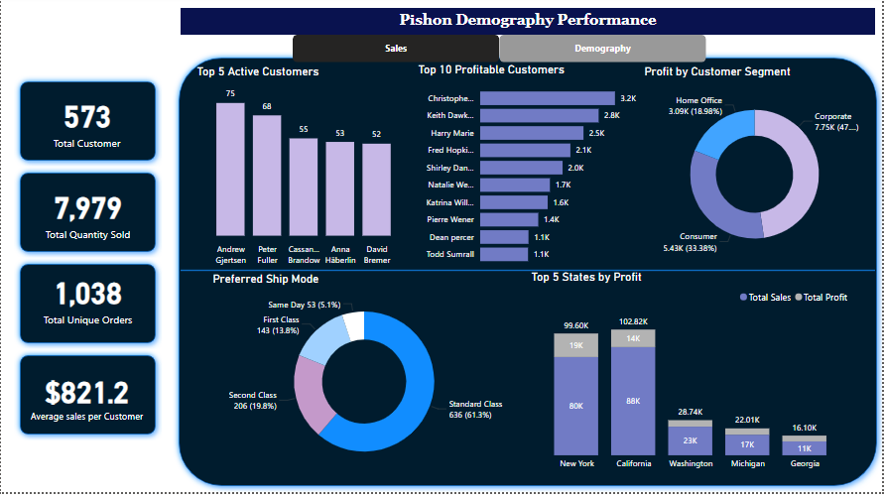

Slide 5
SUMMARY
Sales Performance:
- Positive sales trend with a profit margin of 13.10%
- California branch generated highest revenue ($88.4K)
- New York branch achieved highest profit margin ($19.8K)
Product Performance:
Technology products led with highest profit margin (20.58%)
- Furniture had lowest profit margin (1.8%)
Corporate segment contributed highest profit (47.6%)
Seasonal Trends:
Sales declined sharply in October but peaked in November
Recommendations:
- Invest more in technology and office supplies for business growth and sustainability

Slide 6
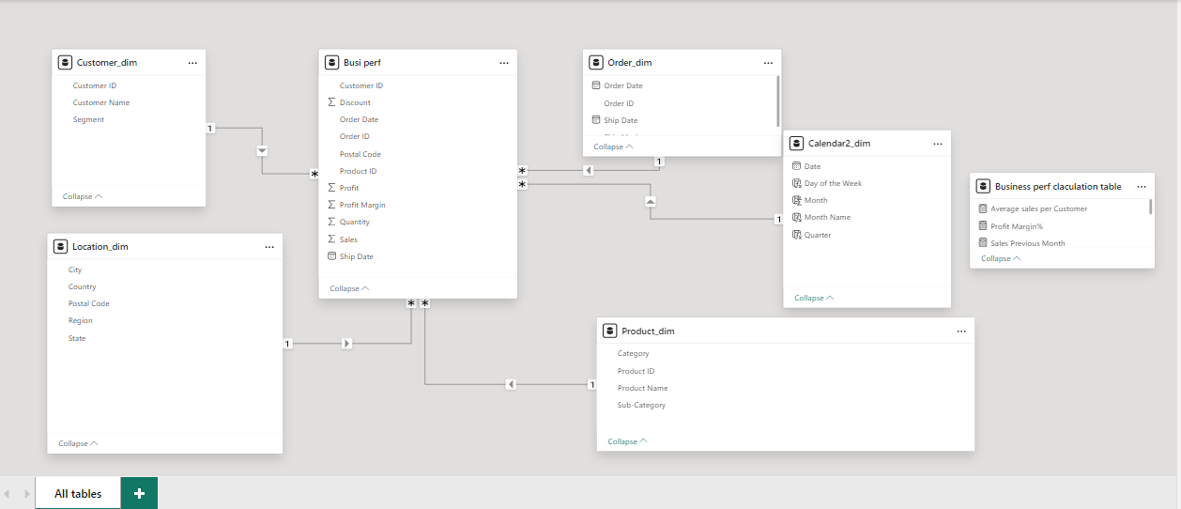
DATA MODELING

Slide 7
Thank you

